Slide 1

Field Collection Information Management at NMNH
NMNH Informatics Office
15 May 2014

Slide 2
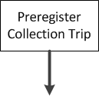
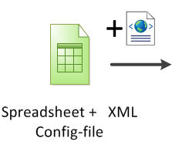
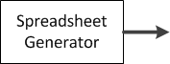
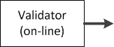
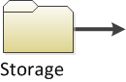
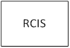
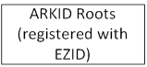
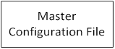
Field Information Management Workflow

Slide 3
Field Information Management Workflow

Slide 4
Field Information Management Workflow

Slide 5
Field Information Management Workflow
Preregistration of permits/agreements in EMu to initiate collecting trip is a requirement and will need subsequent discussion and supporting policy†.
Preregistration will assure that any collecting trip will have an acquisition transaction record already in EMu for later referencing and appending and collectors can populate their field templates with these acquisition numbers before going into the field.
† Creates a transaction record “Acquisition (Collected for Museum)” in EMu.
This is a placeholder for the collection trip and you get a nifty Accession No: e.g. 2999999 for the collection.

Slide 6
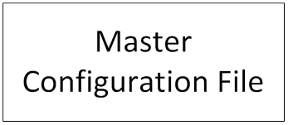
Field Information Management Workflow

Slide 7
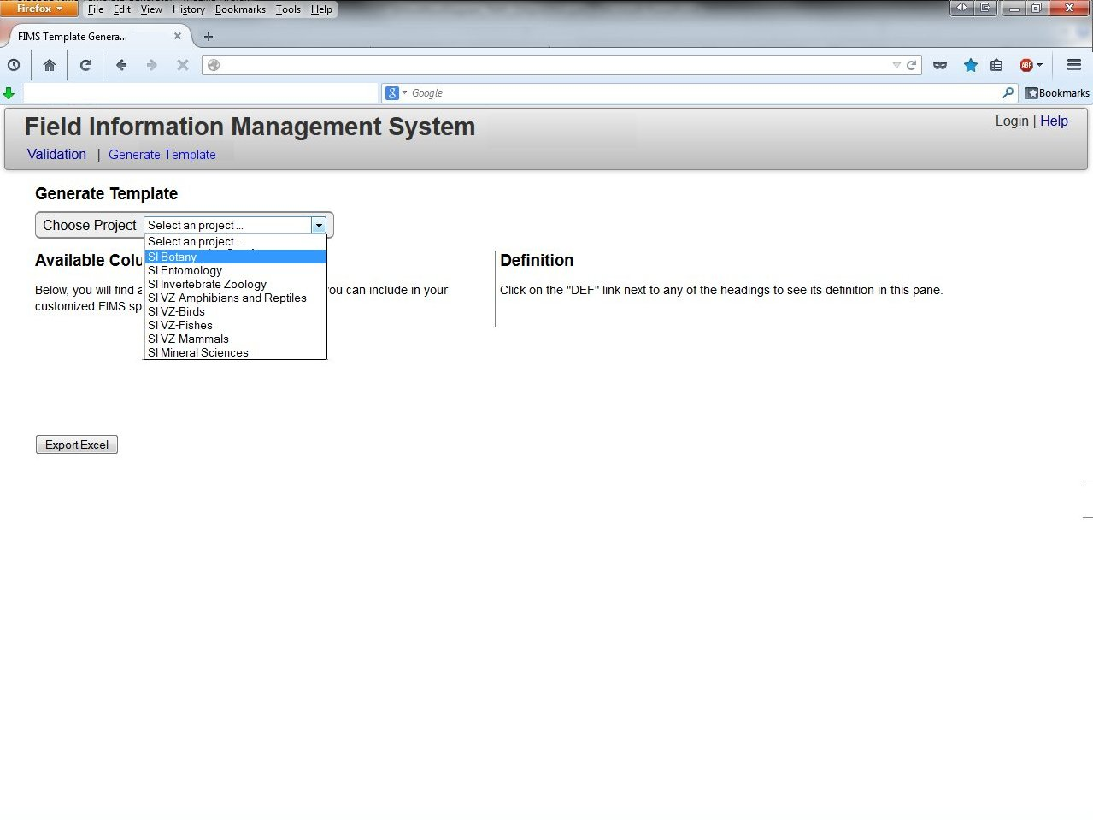

Slide 8
Field Information Management Workflow
Version 1 Field Information Management System
Department Level (project) Templates
Templates will reflect a desired subset of all fields (across most discipline collection types) , based on Departmental or project input.
Templates will ultimately result in robust EMu records for a collection trip

Slide 9
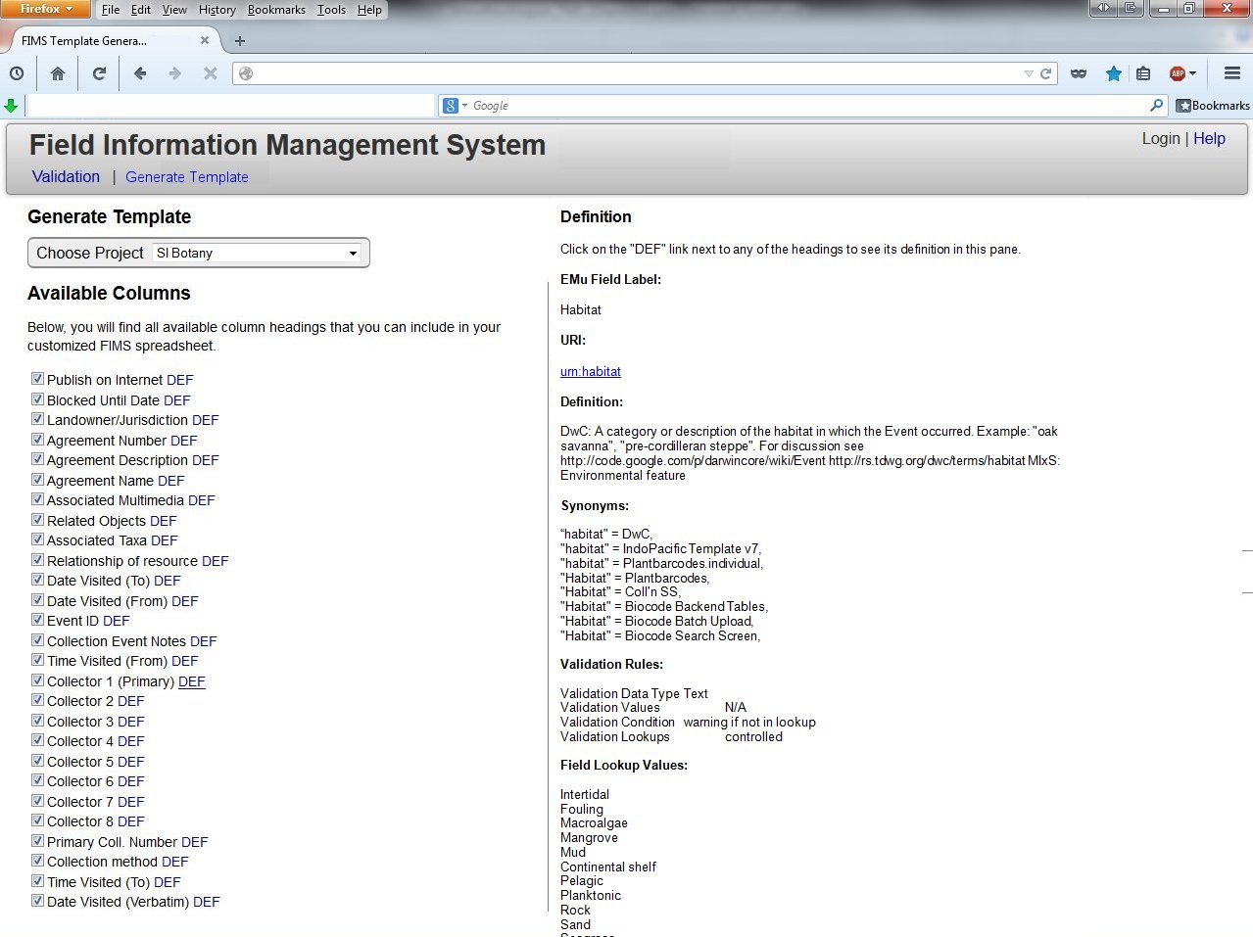
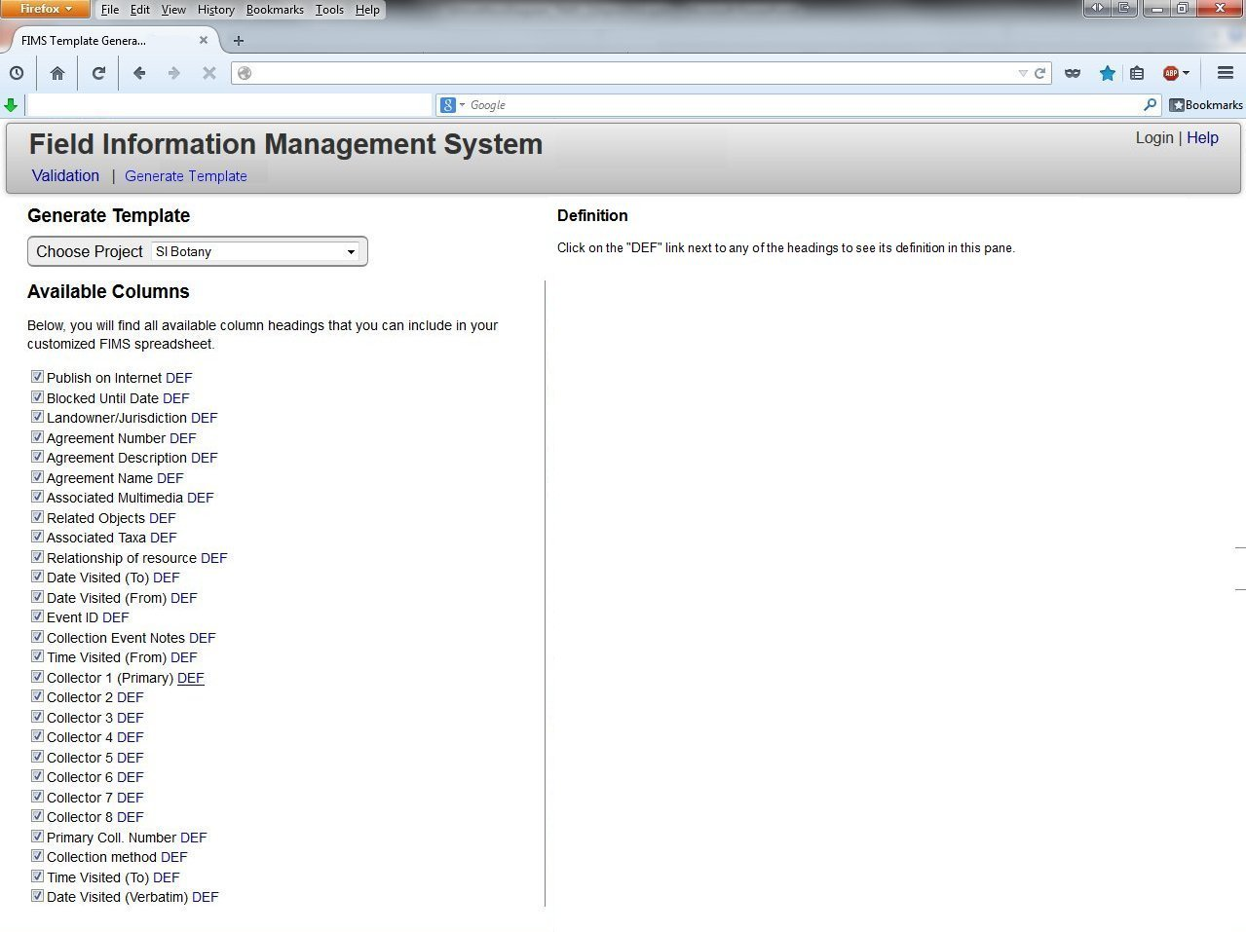

Slide 10
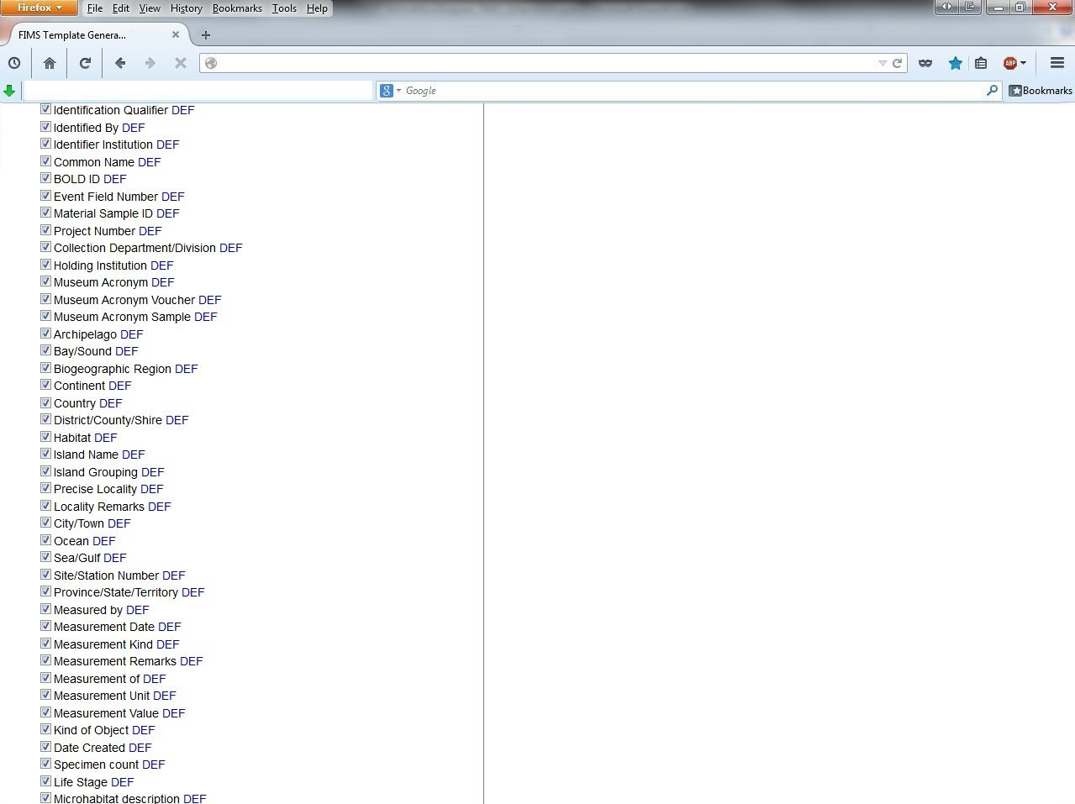

Slide 11


Slide 12
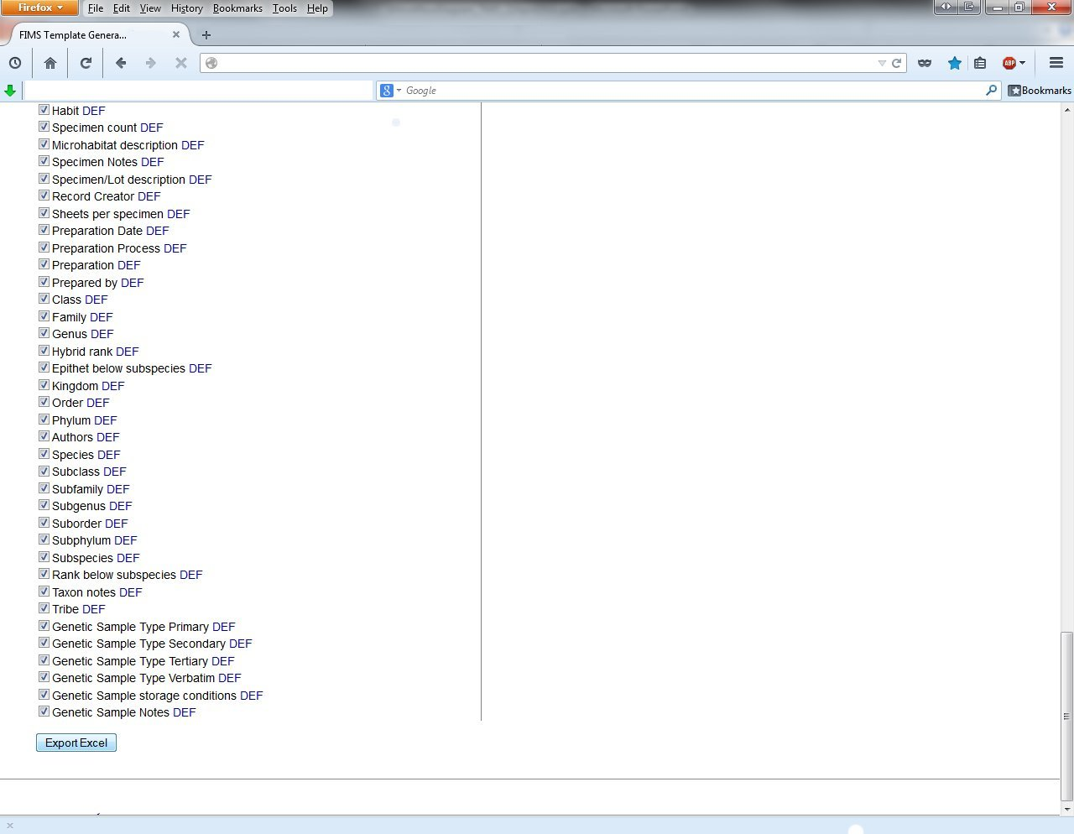

Slide 13
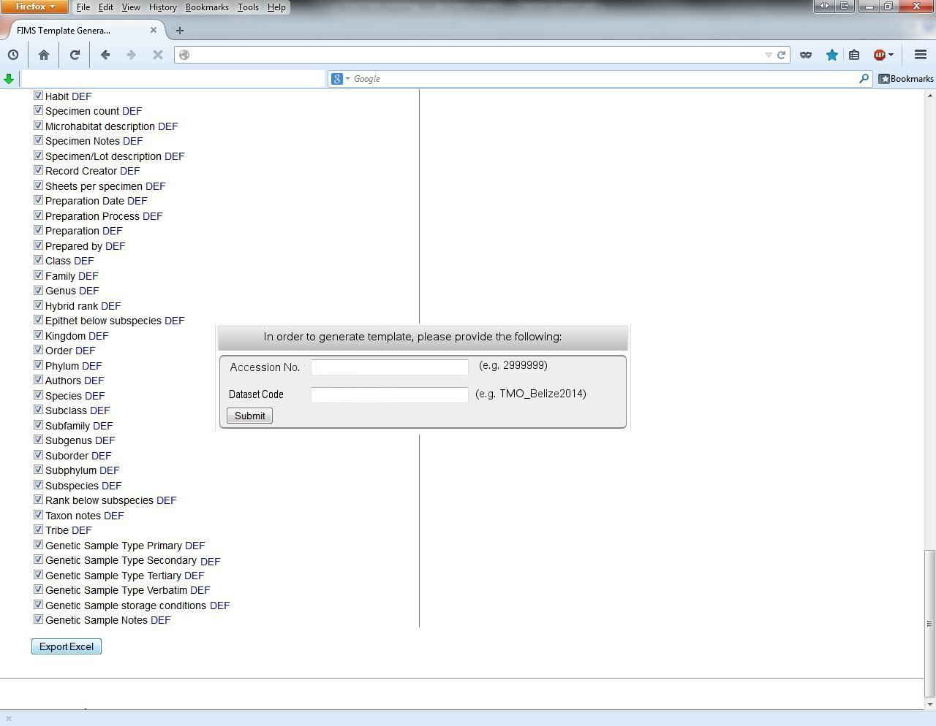

Slide 14
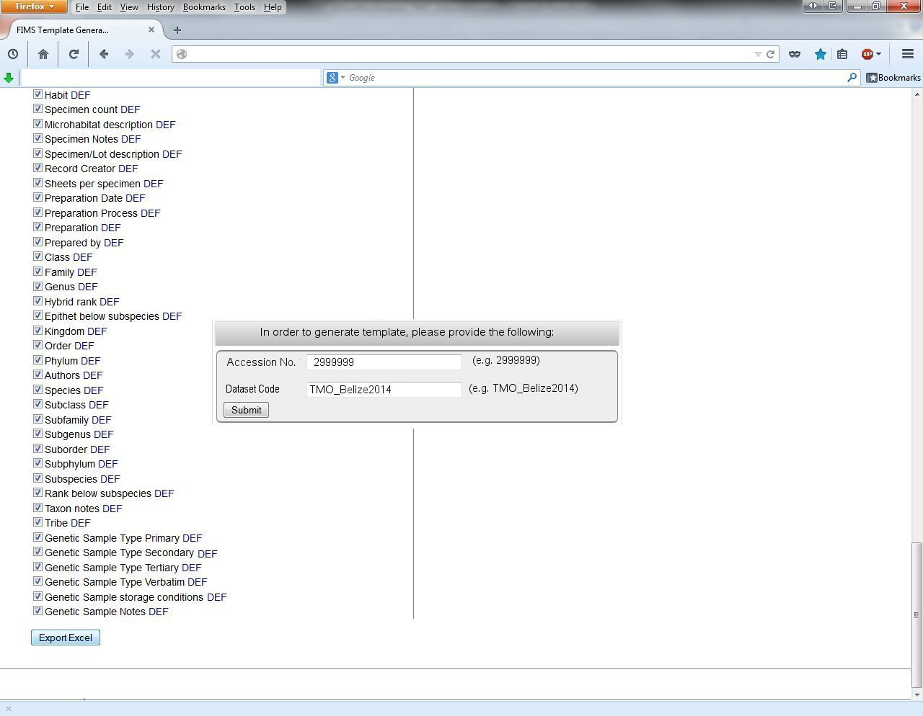

Slide 15
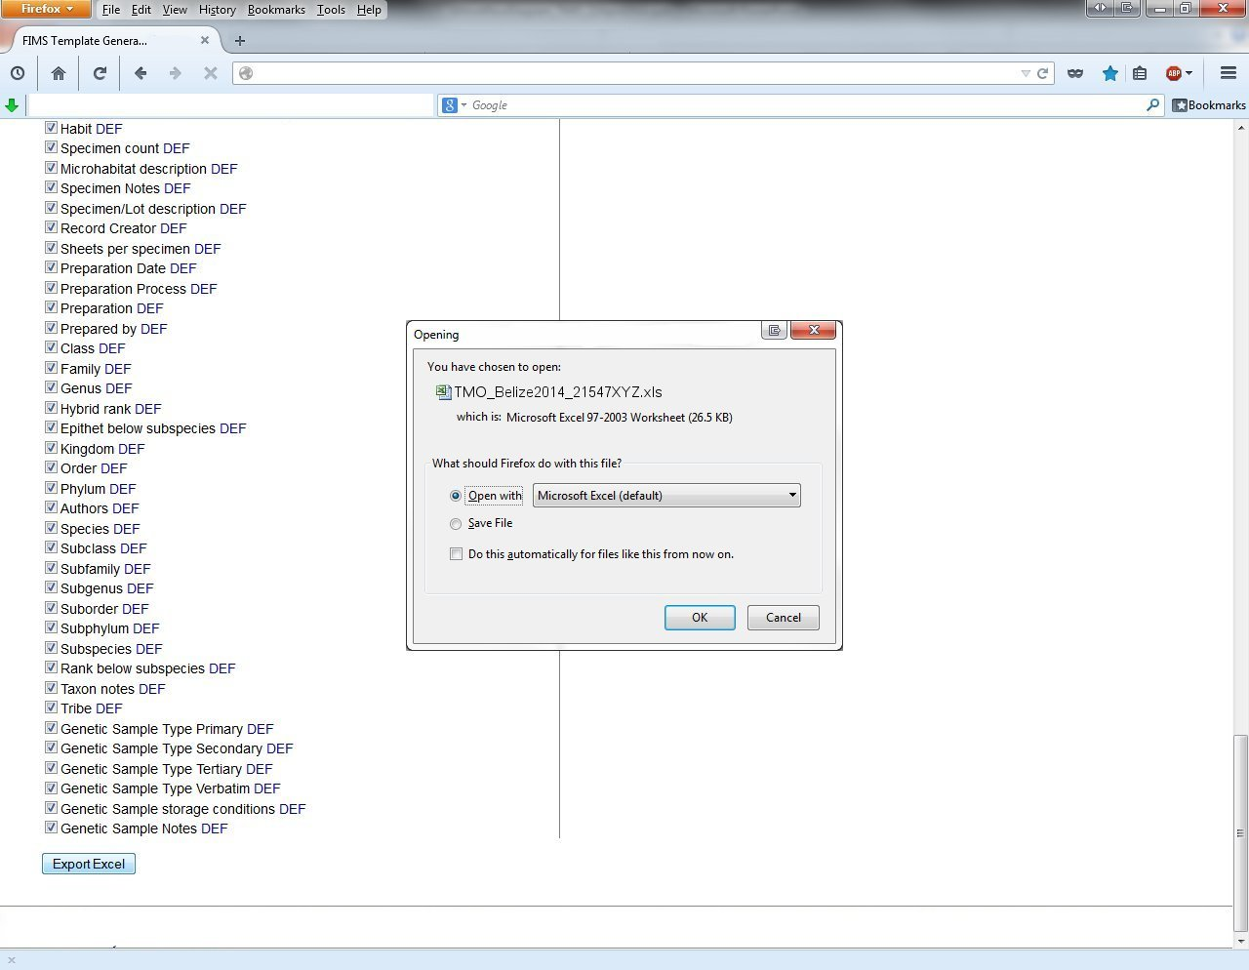

Slide 16
Field Information Management Workflow

Slide 17
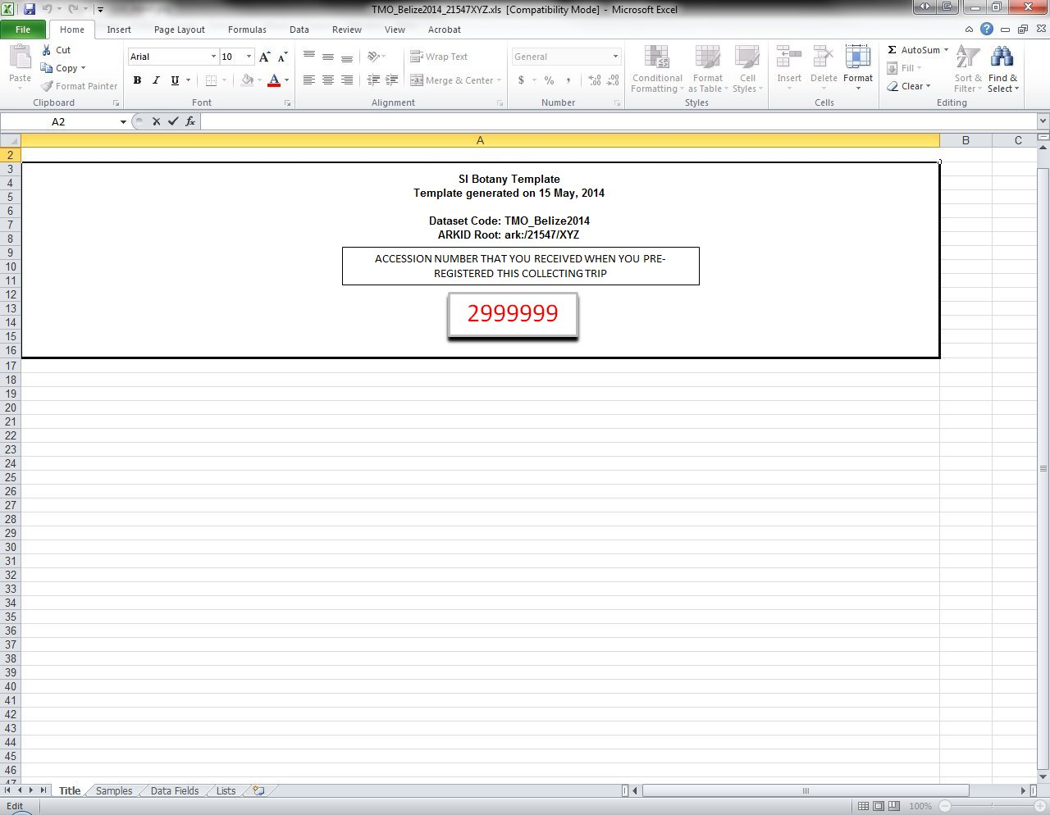

Slide 18
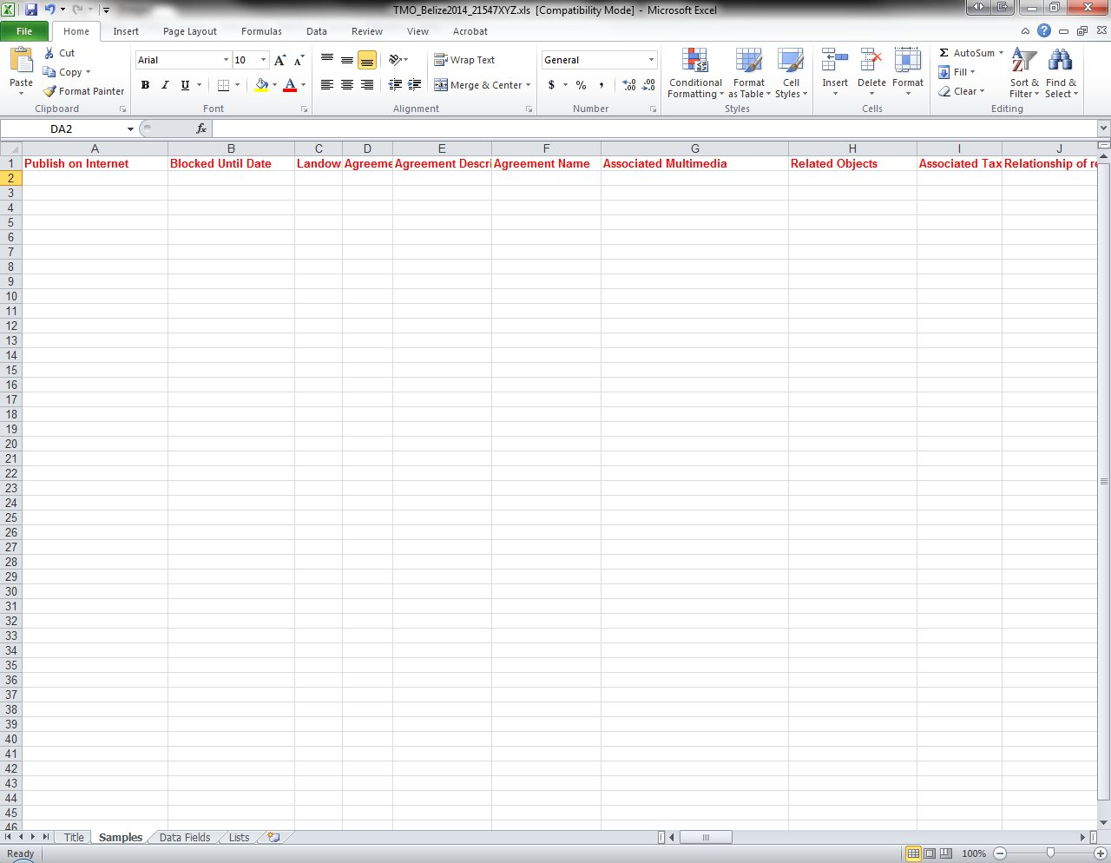

Slide 19
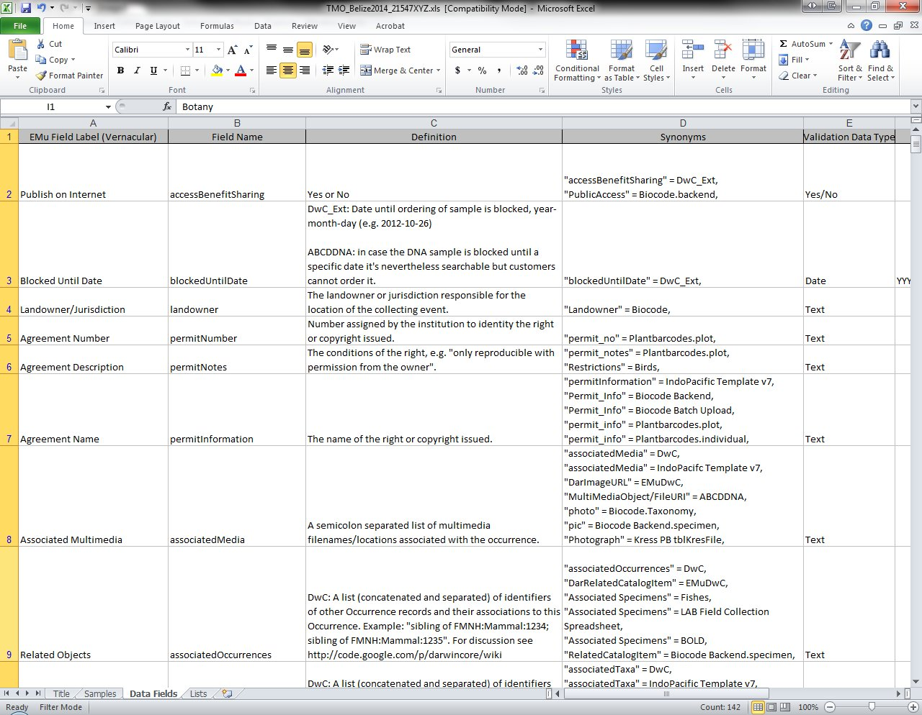

Slide 20
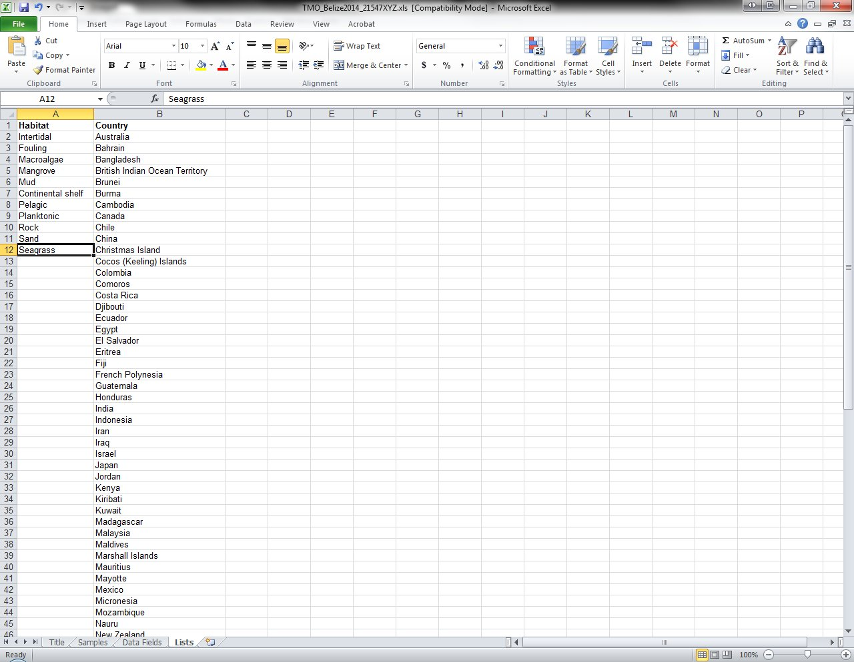

Slide 21
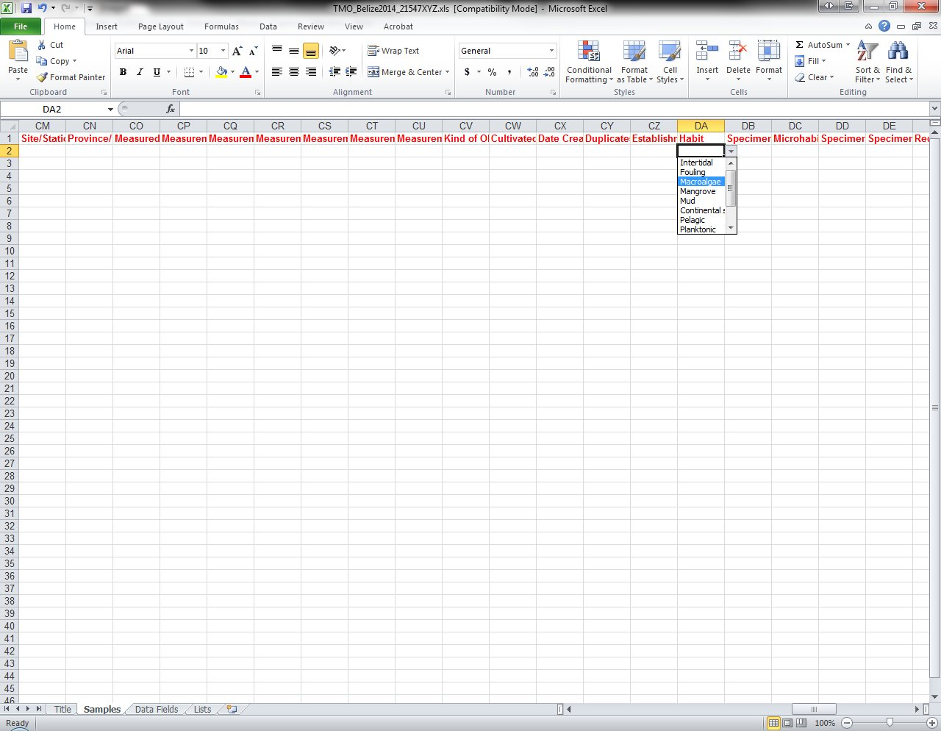

Slide 22
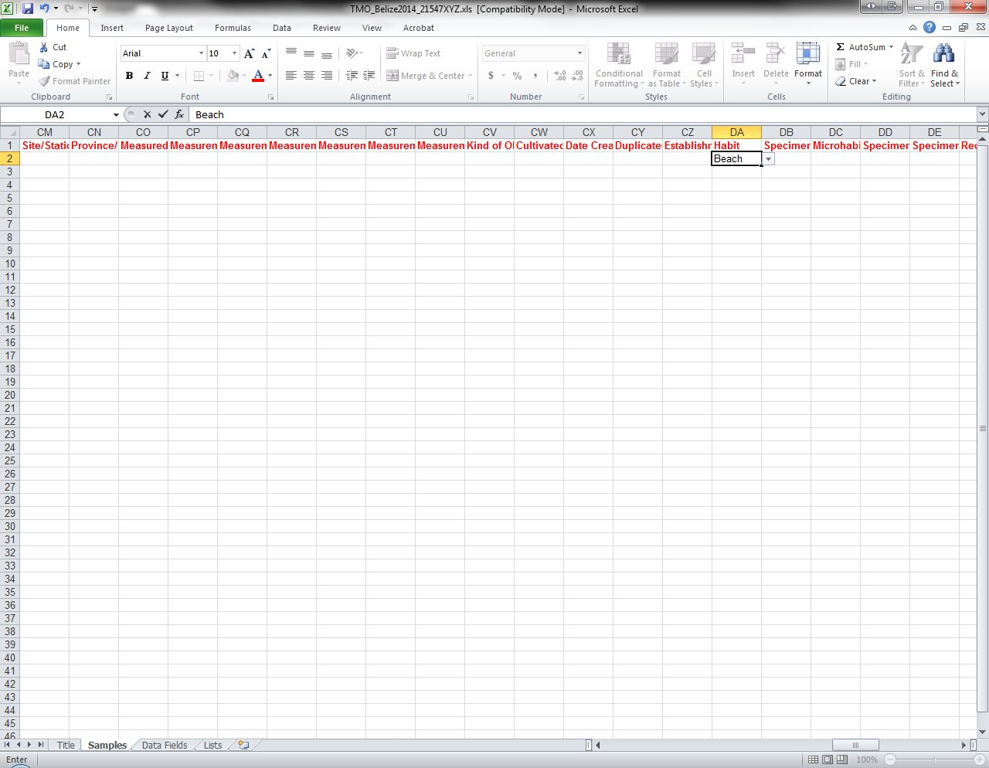

Slide 23
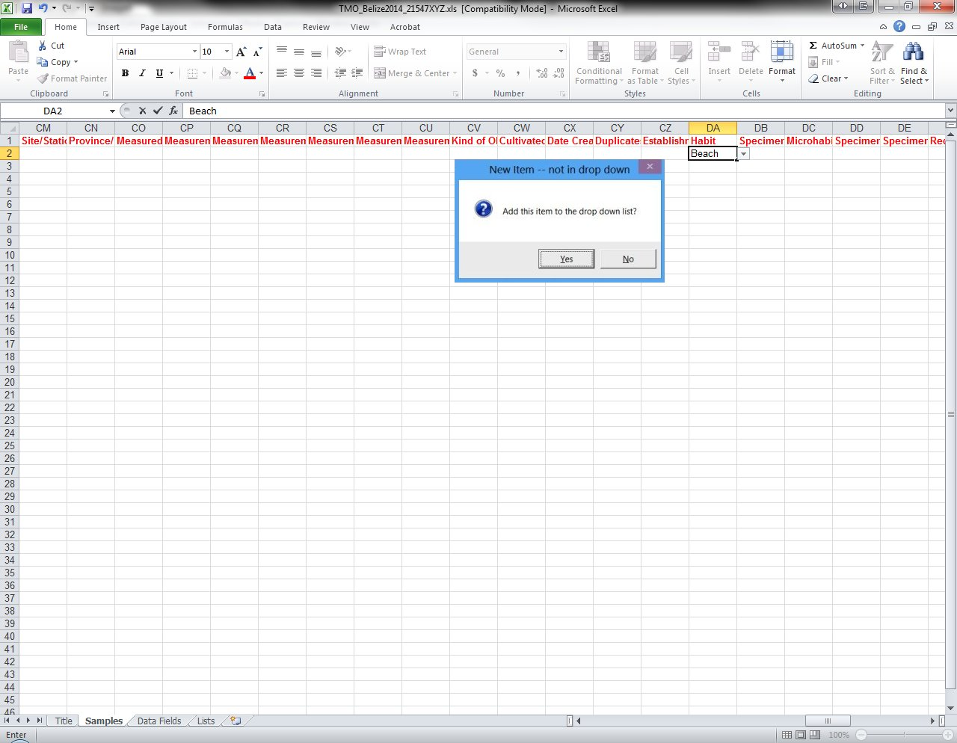

Slide 24
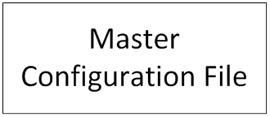
Field Information Management Workflow

Slide 25
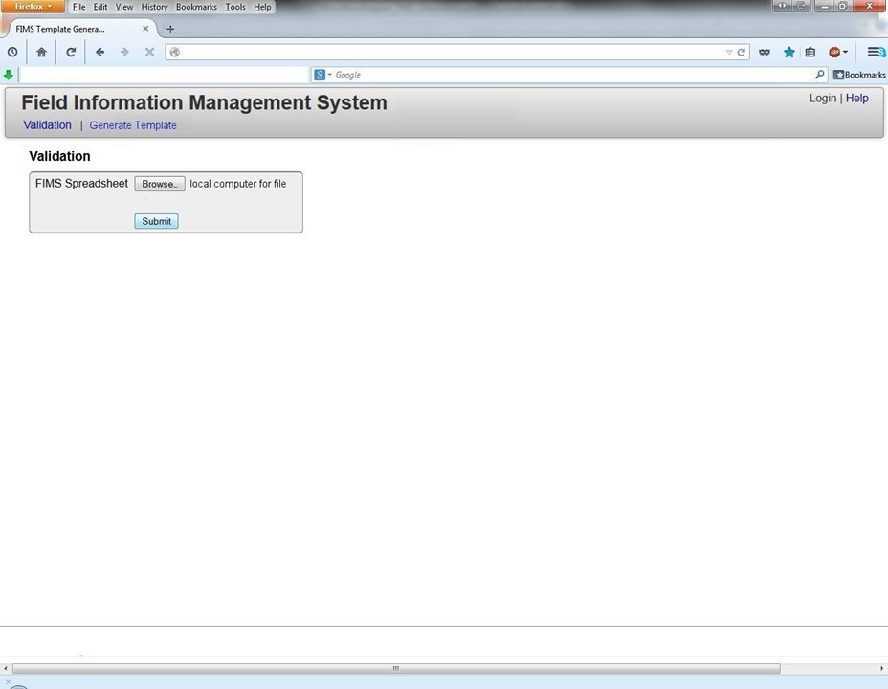
Field Information Management Workflow

Slide 26
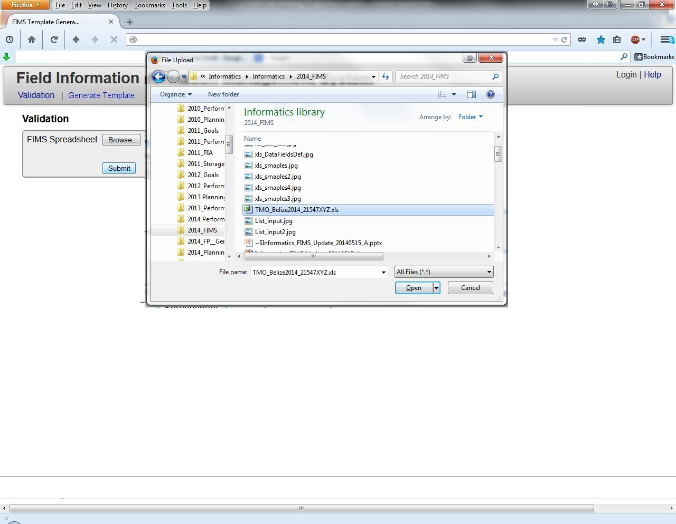
Field Information Management Workflow

Slide 27
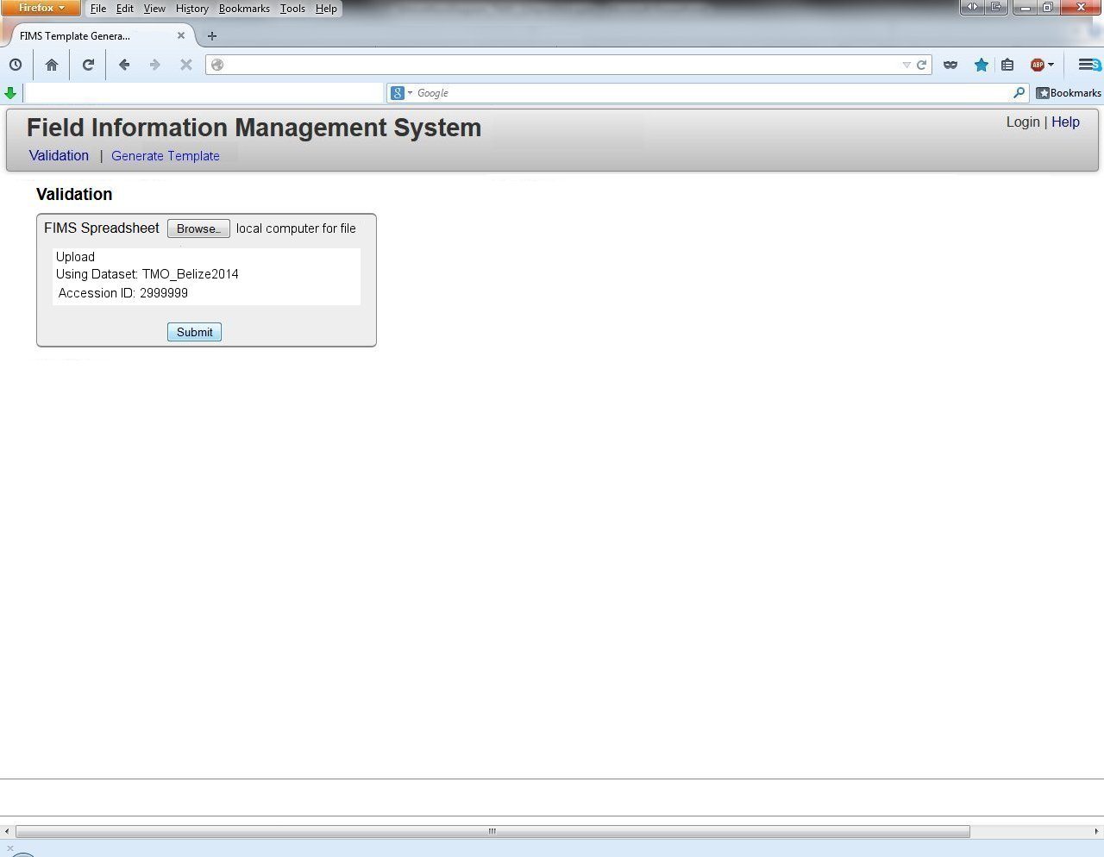
Field Information Management Workflow

Slide 28
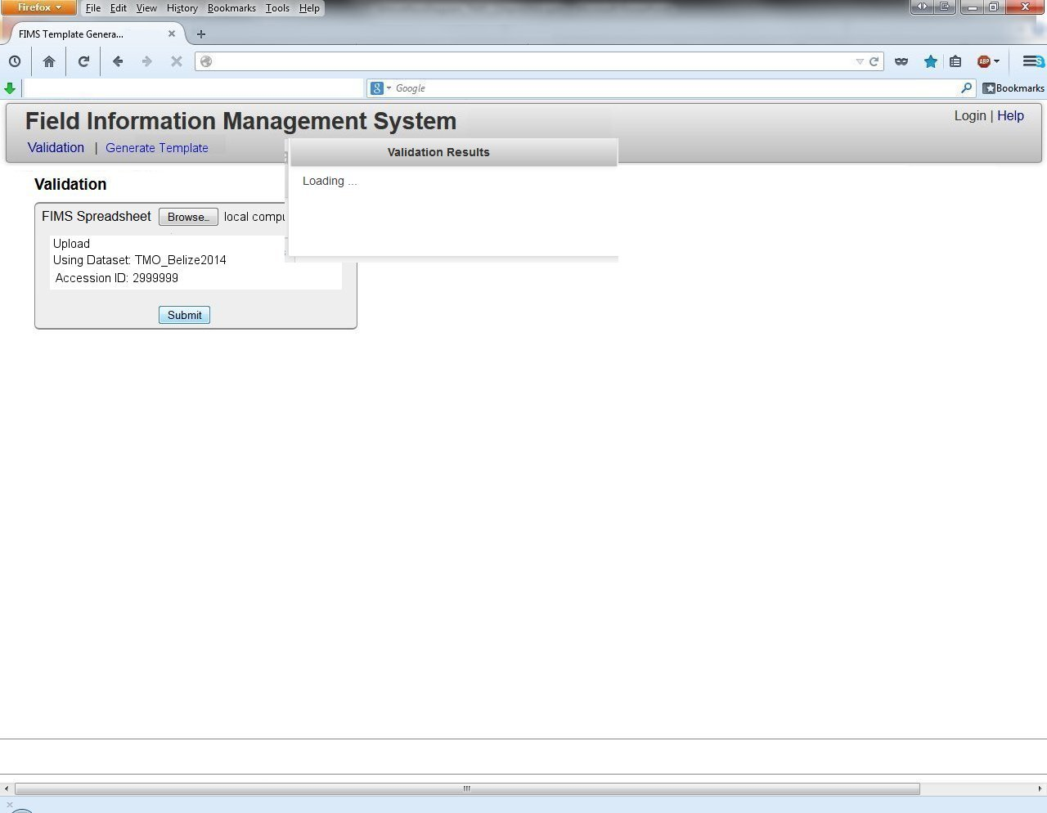
Field Information Management Workflow

Slide 29
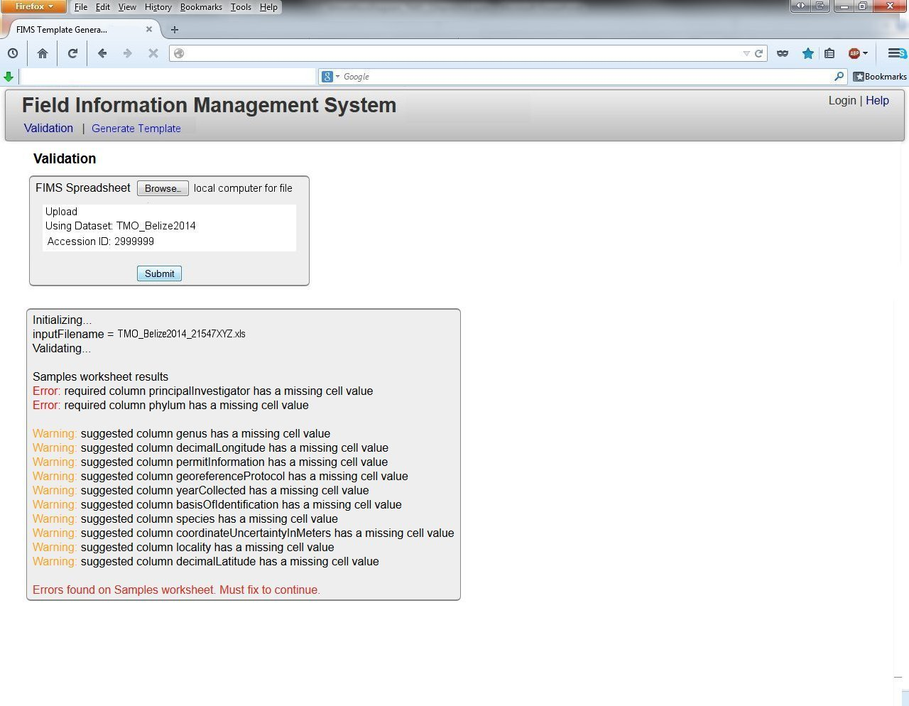
Field Information Management Workflow

Slide 30
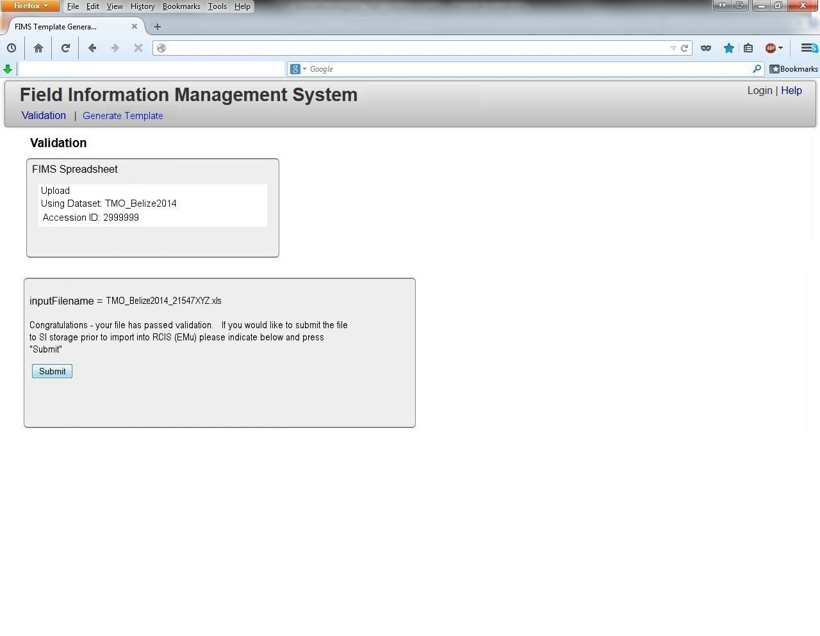
Field Information Management Workflow

Slide 31
Field Information Management Workflow

Slide 32
Field Information Management Workflow

Slide 33
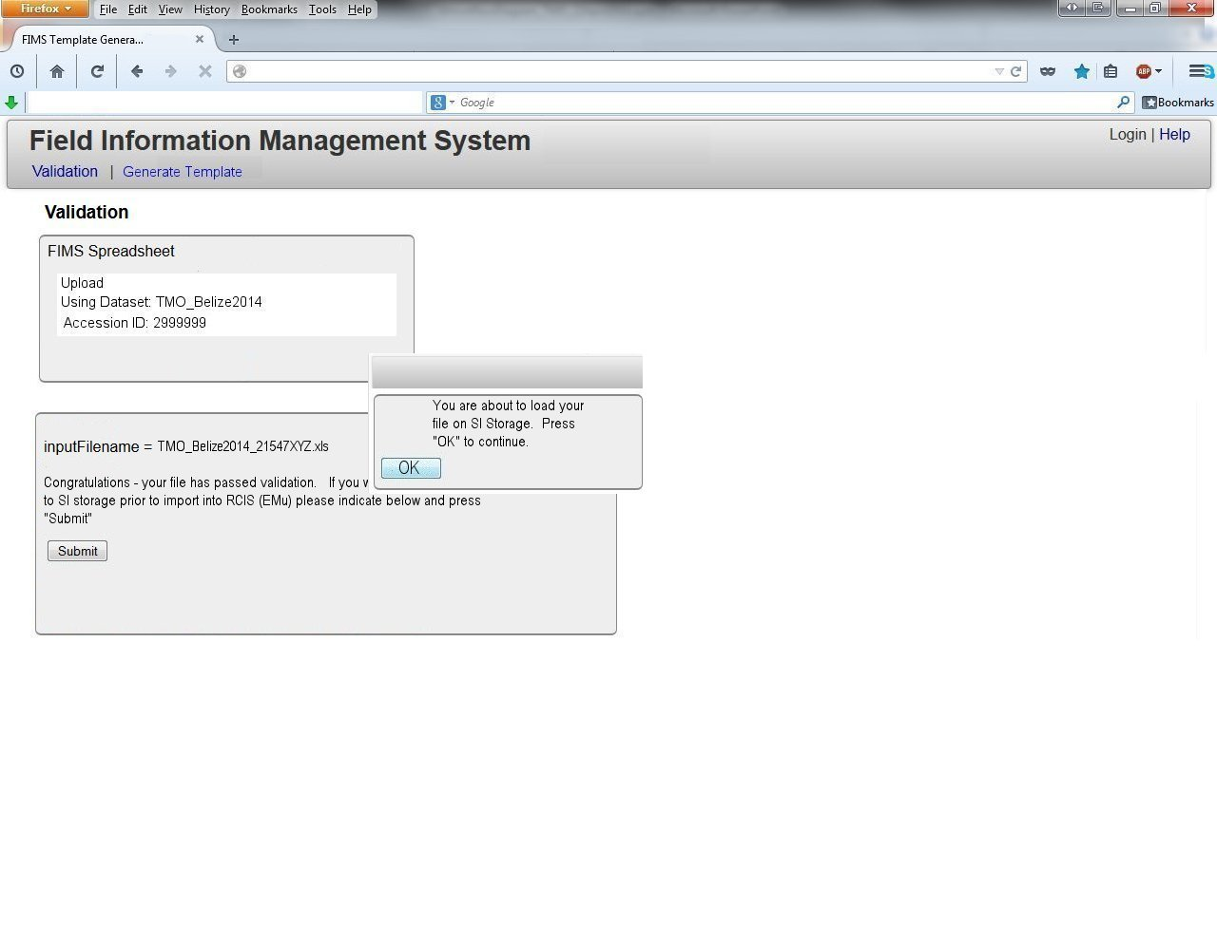
Field Information Management Workflow

Slide 34
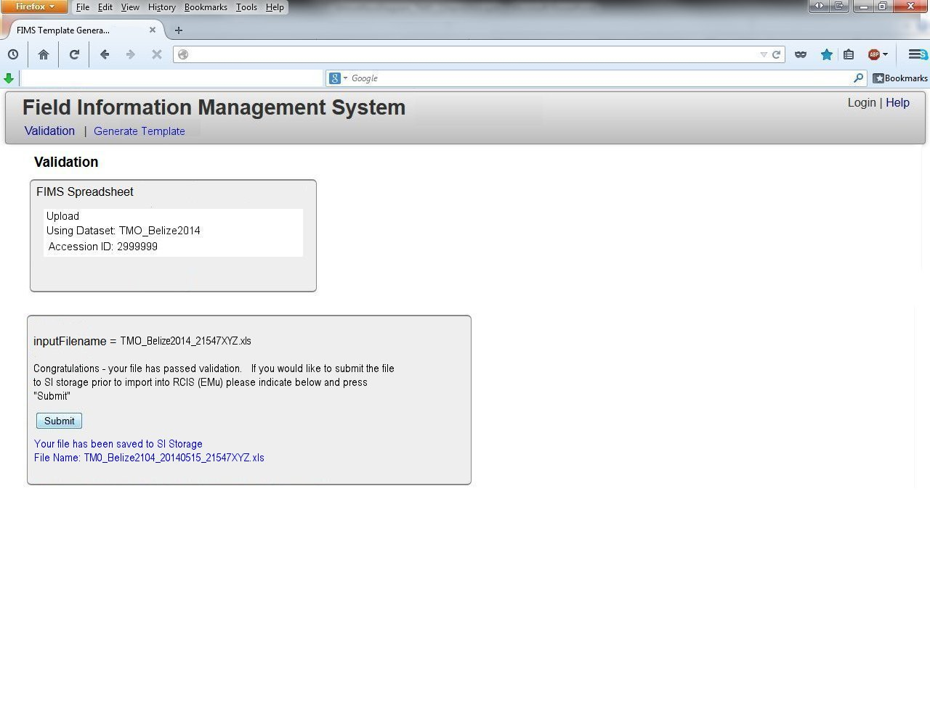
Field Information Management Workflow

Slide 35



Field Information Management Workflow
FIMS Spreadsheet Generator
FIMS Staging Area Storage
CRON
SI “Scientific Zone”
SI Intranet

Slide 36

Field Information Management Workflow

Slide 37
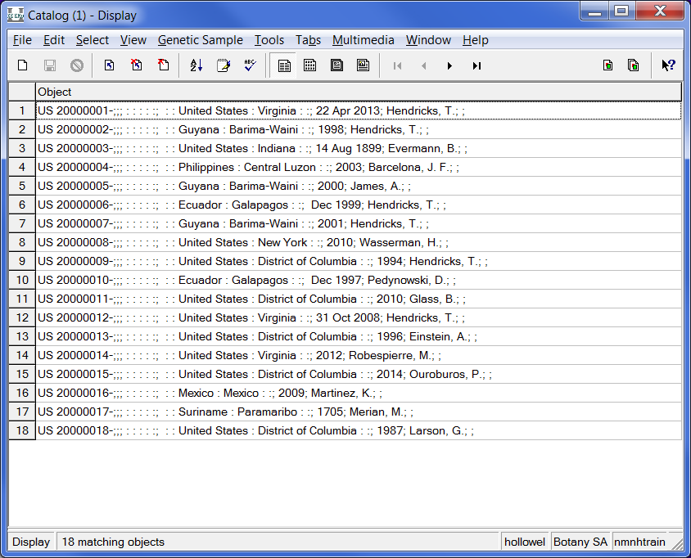

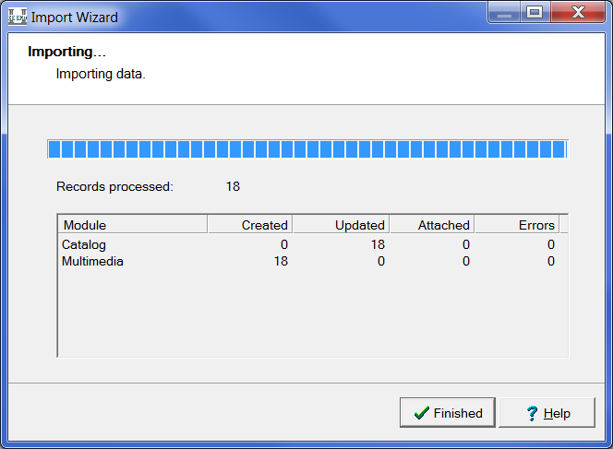

Field Information Management Workflow
Storage

Slide 38
V1 / V2 FIMS rollout goals
Field Information Management Development
V1 = September 1, 2014
V2 = After September 1, 2014

Slide 39
V1 Features already built (as of May 15, 2014)
Field Information Management Development
Validation engine
Open authentication/login system
Integration with EZID system
Project Management console
Web interface
Template Generator
A simple Query System

Slide 40
V1 FIMS Features Still to be Built
Field Information Management Development
Single purpose spreadsheets
Add Dataset Codes / Accession IDs at template generation, after clicking “Create Excel”
Template generator:
Collapsible sets of terms in Template Generator
Mandatory fields first, Requested fields pre-checked
Lookup lists associated with terms popup
Script the generation of departmental and project-specific configurations
Validation:
toggle between summary of errors and a line-by-line detailed list of errors (like bioValidator)
Save and print list of errors (locally and send to server with spreadsheet)
Upload to Server (reading dataset code, accession id)
Add Link to Open Refine
Test deployment on Jetty (publicly facing server to host software)
VBA – add value to lookup just on spreadsheet (? See if this can be done with Apache POI)
Enable Vlookups (for power-users)

Slide 41
V2 FIMS Development
Field Information Management Development
Fuzzy matching search terms in template generator based on synonyms column
Skinning interface
Web-based XML configuration automation (GRM) ABI grant
LDAP integration
Store templates by user
Extended user support (through first year after release)
Better Date validation
More integration with Open Refine
Match photos to spreadsheet using unique IDs (in scope?)

Slide 42
Important Dates
Field Information Management Development
July 15, 2014
Freeze V1 major features and release for testing.
September 1, 2014
V1 rollout
After September 1, 2014
V2 development; V1 support – Needs funding

Slide 43
Discussion

